Slide 1
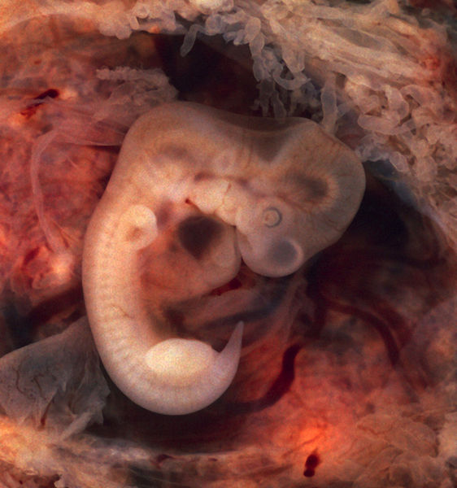







Significance and Implications of Mitosis and Meiosis

Slide 2
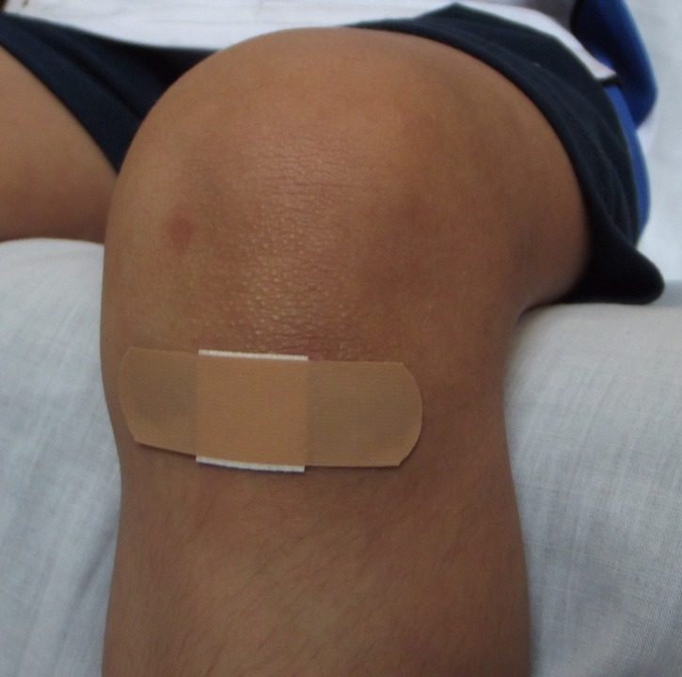
Do you still have scars from the wounds that you had as a kid?

Slide 3
Cell division, both mitosis and meiosis, is an essential process that covers a wide array of functions, from wound healing to growth and development, and to the formation of gametes in sexually reproducing organisms.

Slide 4
What will happen if cell division fail to function?

Slide 5
Why are both mitosis and meiosis important? How do these processes impact organisms?

Slide 6
The Significance of Mitosis
maintenance of genetic material
growth and development
Significance of Mitosis
repair and recovery
asexual reproduction

Slide 7
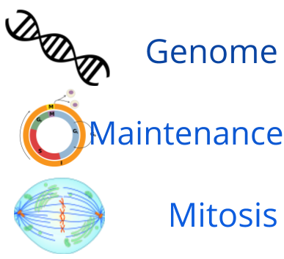
The Significance of Mitosis
Maintenance of genetic material
complete set of genetic material in somatic cells
Growth and development
Genome must be maintained to ensure proper biological functions.
Repair and recovery
This division allows complete set of genetic material to be inherited.
Asexual reproduction

Slide 8
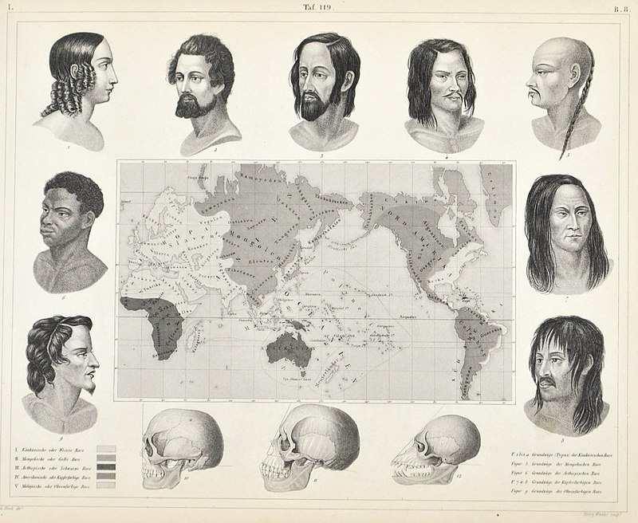
The Significance of Mitosis
Maintenance of genetic material
Growth and development
Repair and recovery
Asexual reproduction
The genome of an organism dictates its characteristics. It can also be attributed to the various traits such as the diversity of facial features.

Slide 9
What will happen to an organism if its cells all have different combinations of genetic information?

Slide 10
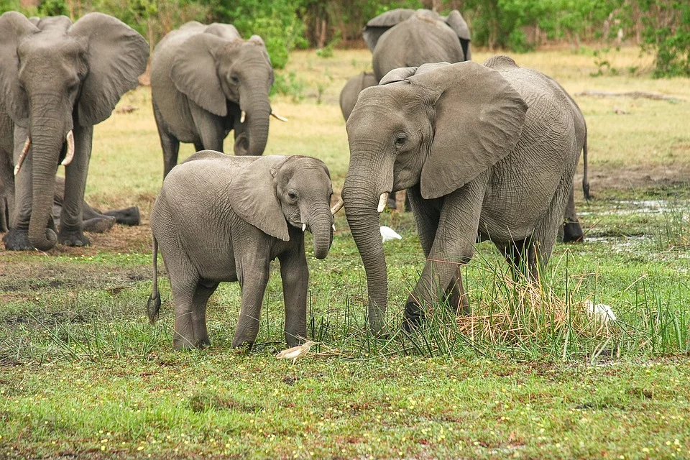
The Significance of Mitosis
Maintenance of genetic material
Growth and development
Repair and recovery
Asexual reproduction
Organisms as huge as the elephants grow through repeated mitosis.

Slide 11
The Significance of Mitosis
Maintenance of genetic material
growth as an essential part of an organism’s maturity
Growth and development
growth as the increase in the organism’s size
Repair and recovery
growth achieved through an increase in cell number
Asexual reproduction
growth as a process attributed to mitosis

Slide 12
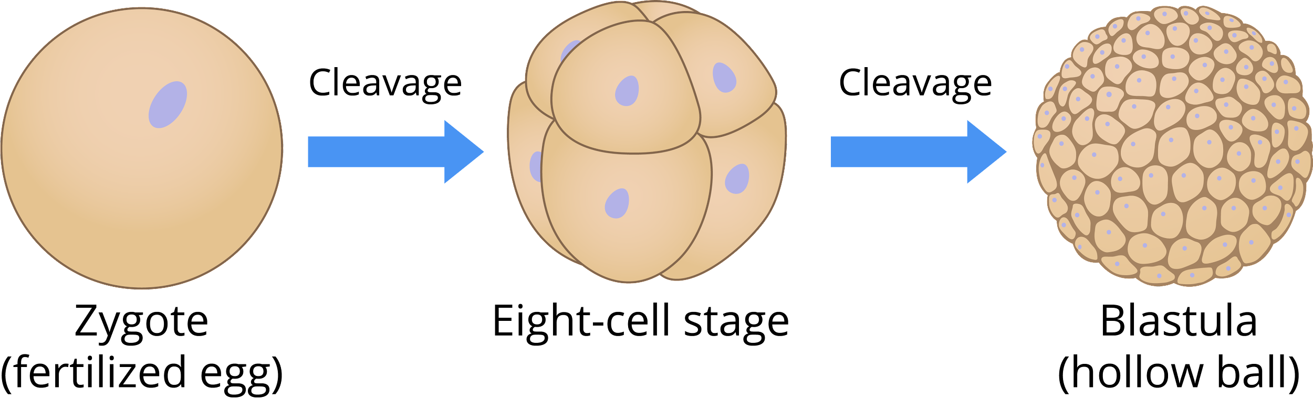
The Significance of Mitosis
Maintenance of genetic material
Growth and development
Repair and recovery
Asexual reproduction
The process of cleavage immediately follows the formation of the zygote.

Slide 13
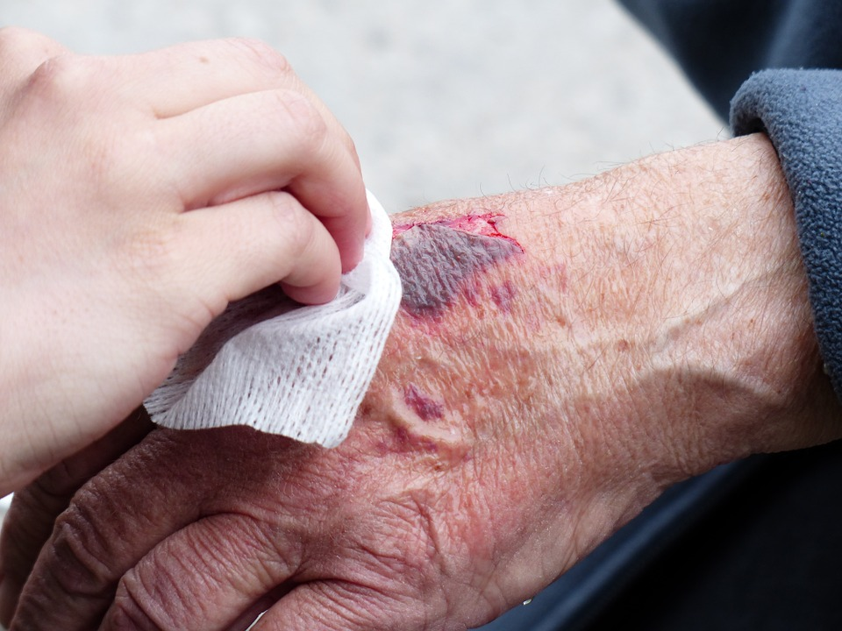
The Significance of Mitosis
Maintenance of genetic material
Growth and development
Repair and recovery
Asexual reproduction
Old and damaged cells are replaced through
mitotic division.

Slide 14
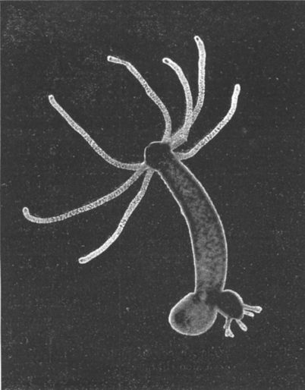
The Significance of Mitosis
Maintenance of genetic material
Growth and development
Repair and recovery
Asexual reproduction
Hydra reproduces asexually through budding.

Slide 15
The Significance of Mitosis
Maintenance of genetic material
Some pressures push an organism to resort to asexual reproduction.
Growth and development
lone parent reproduces asexually
Repair and recovery
mitosis as the primary mechanism of asexual reproduction
Asexual reproduction
Genetic material is completely inherited by the offspring.

Slide 16
The Significance of Meiosis
reduction of genetic material and sexual reproduction
inheritance
Significance of Meiosis
genetic diversity
survival

Slide 17
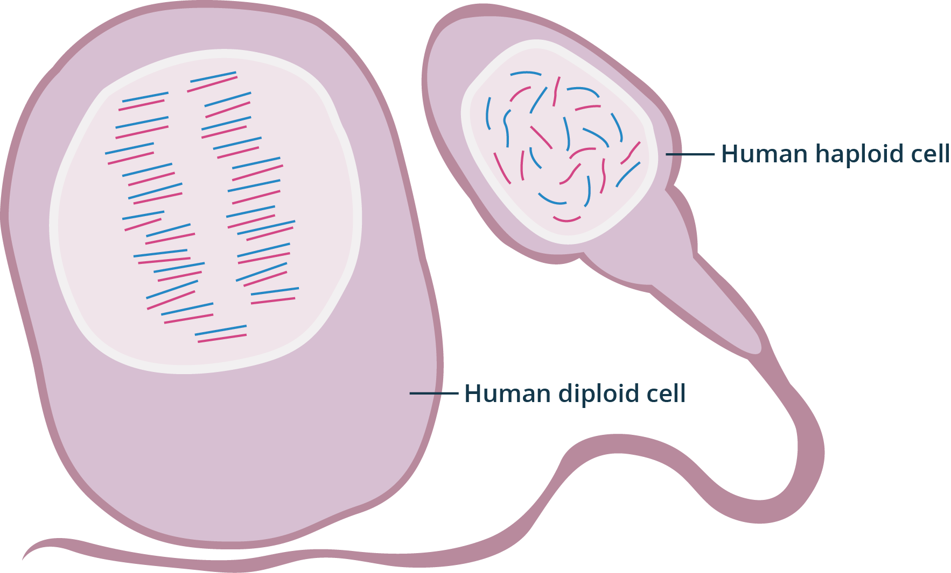
The Significance of Meiosis
Reduction of genetic material and sexual reproduction
Inheritance
Genetic diversity
Survival
All human body cells are diploid
except gametes which are haploid.

Slide 18
The Significance of Meiosis
Reduction of genetic material and sexual reproduction
reduction in chromosome number to produce gametes
Inheritance
allows both parents to contribute genetic material
Genetic diversity
restoration of chromosome number during fertilization
Survival

Slide 19
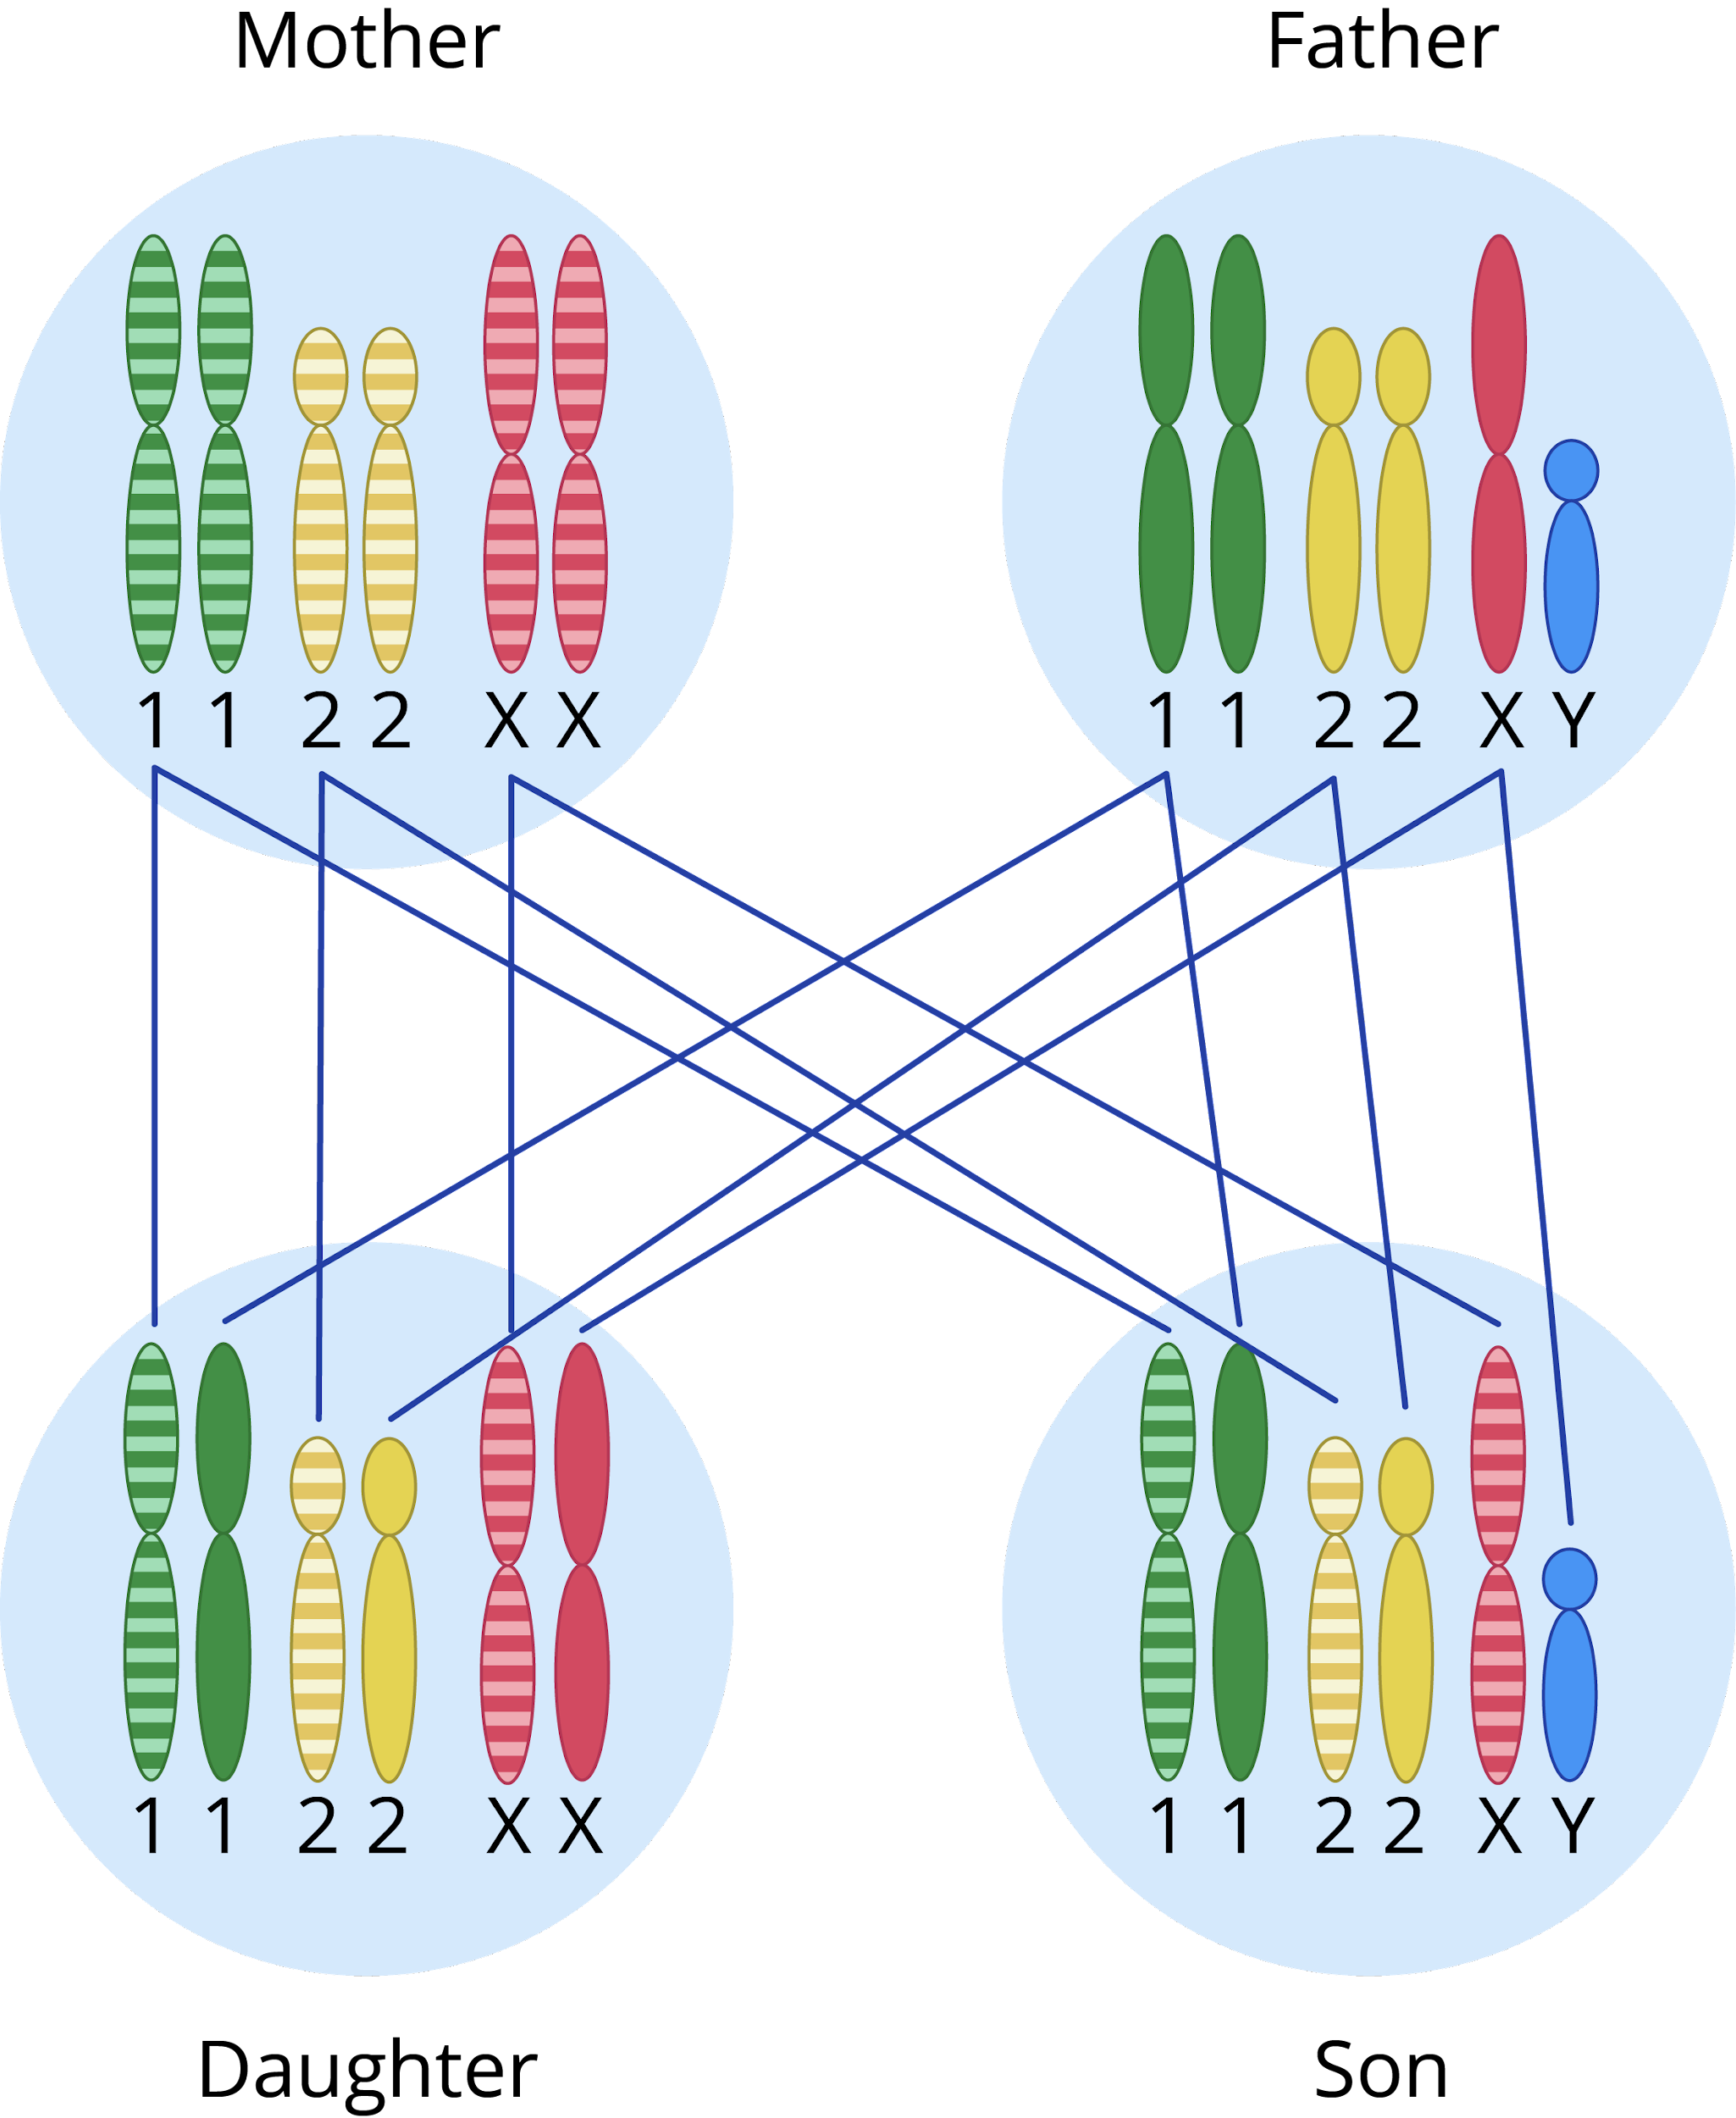
The Significance of Meiosis
Reduction of genetic material and sexual reproduction
An example of how chromosomes are passed from parents to children
Inheritance
Genetic diversity
Survival

Slide 20
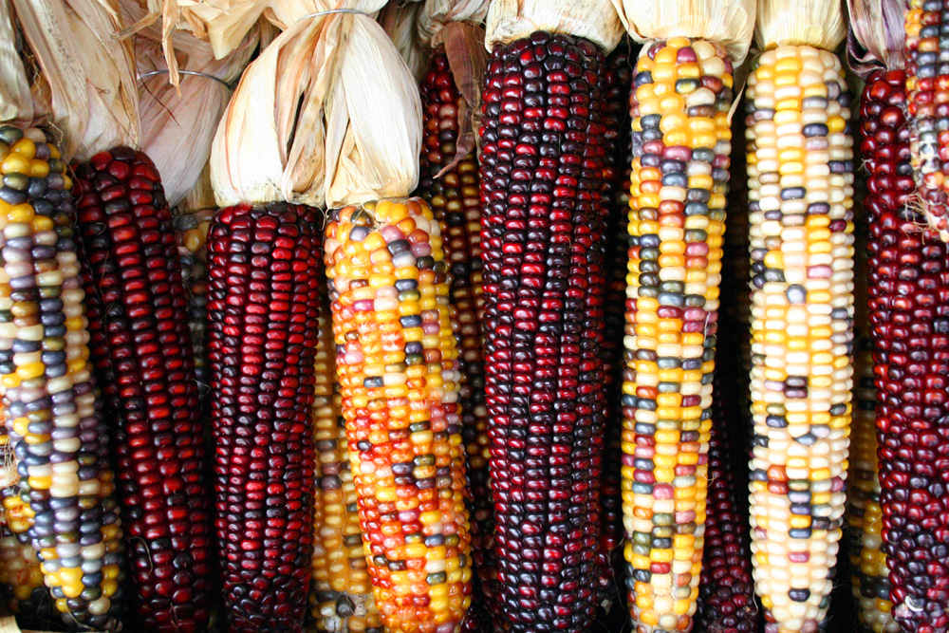
The Significance of Meiosis
Reduction of genetic material and sexual reproduction
Inheritance
Genetic diversity
Survival
Different colors of corn kernel can be an indicator of high genetic diversity.

Slide 21
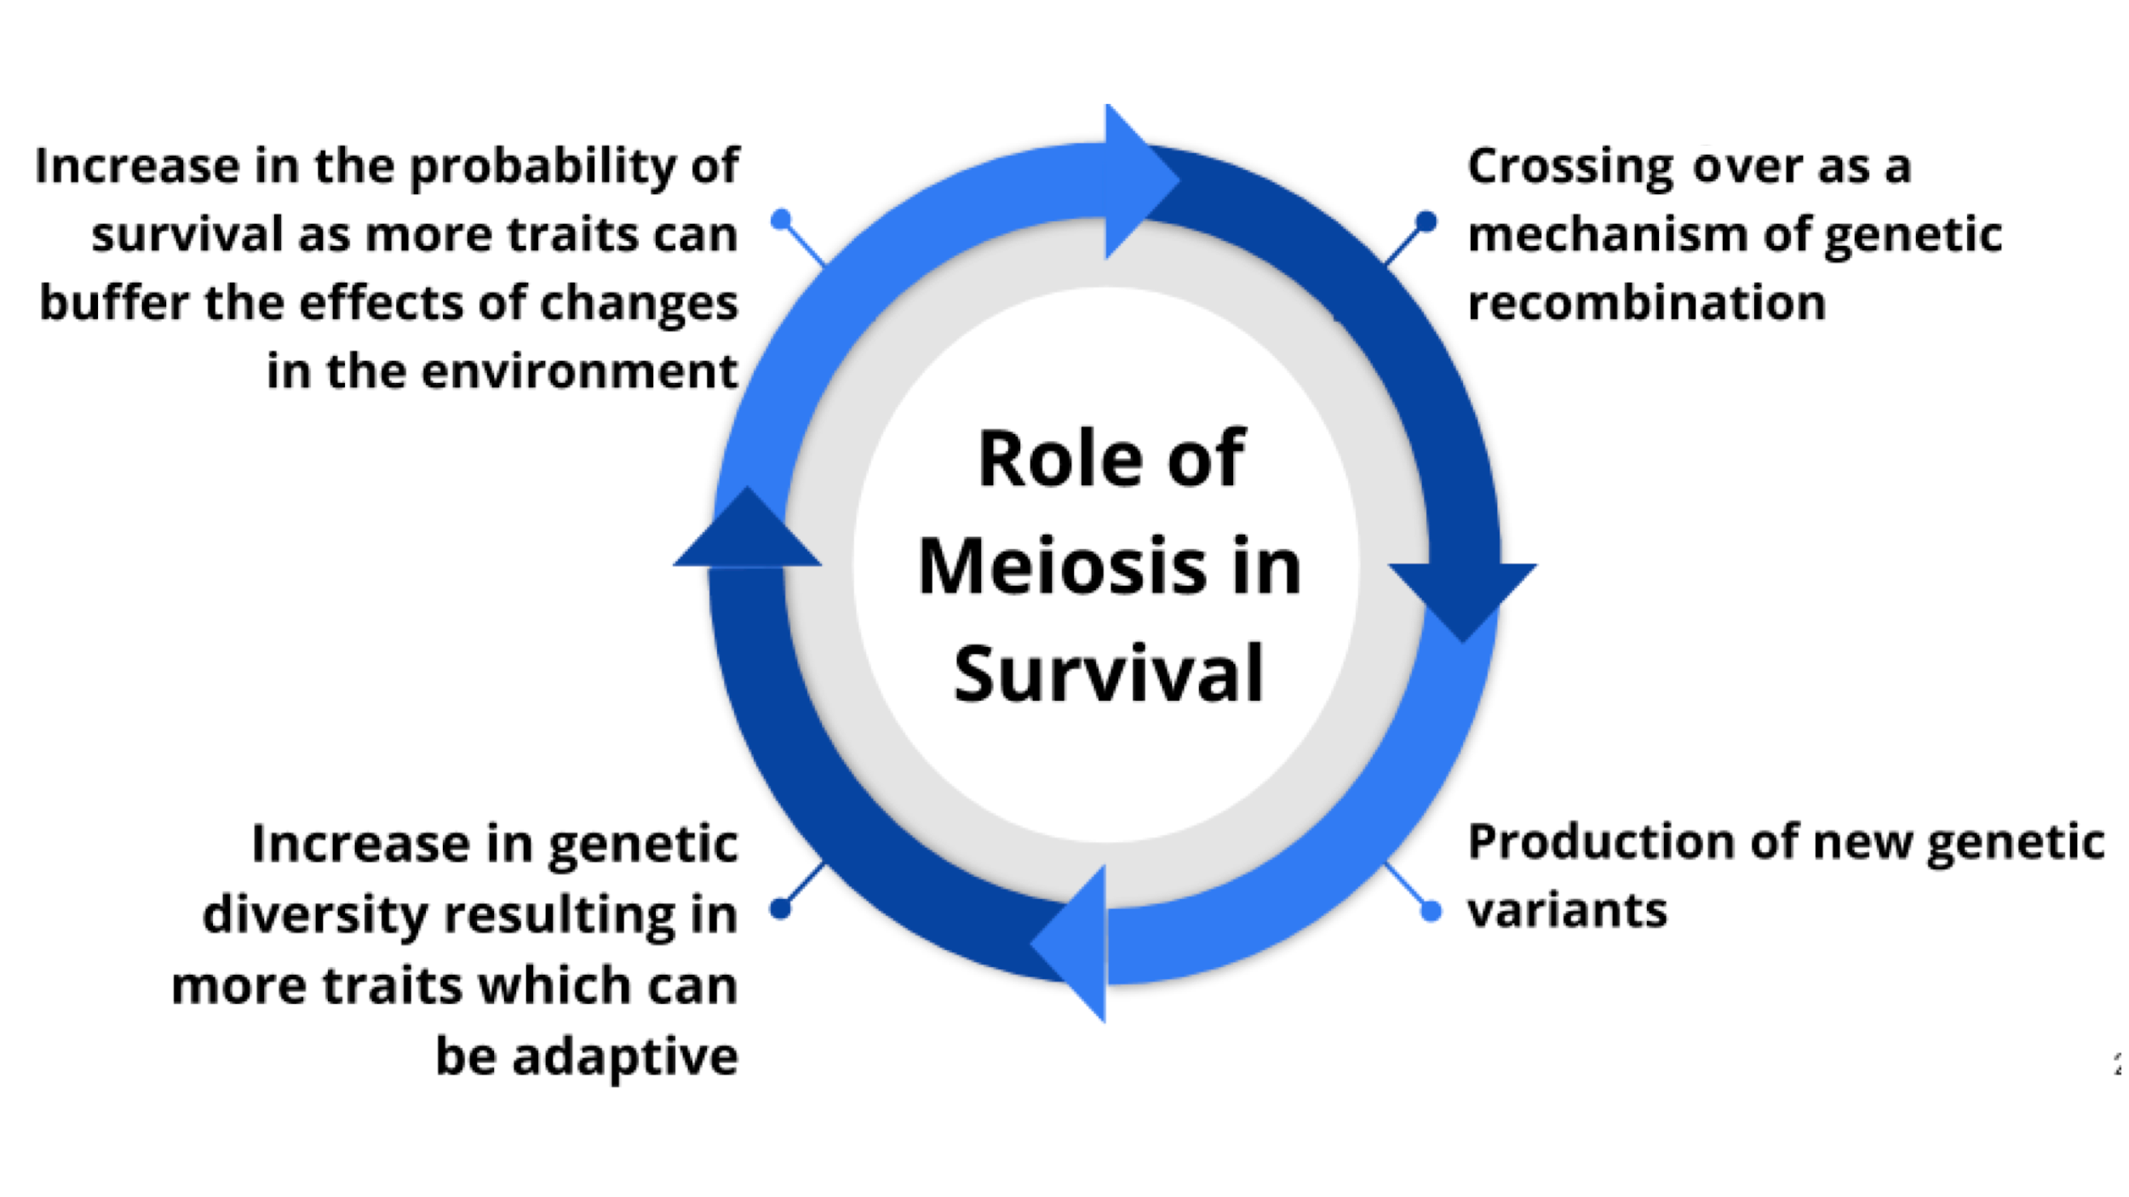
The Significance of Meiosis
Reduction of genetic material and sexual reproduction
Inheritance
Genetic diversity
Survival

Slide 22
The benefits of adaptations are not universal. These largely depend on the environment in question.
For example, having very thick hair that is good for insulation can be beneficial in cold habitats. This is not the case in warmer climates, however.

Slide 23
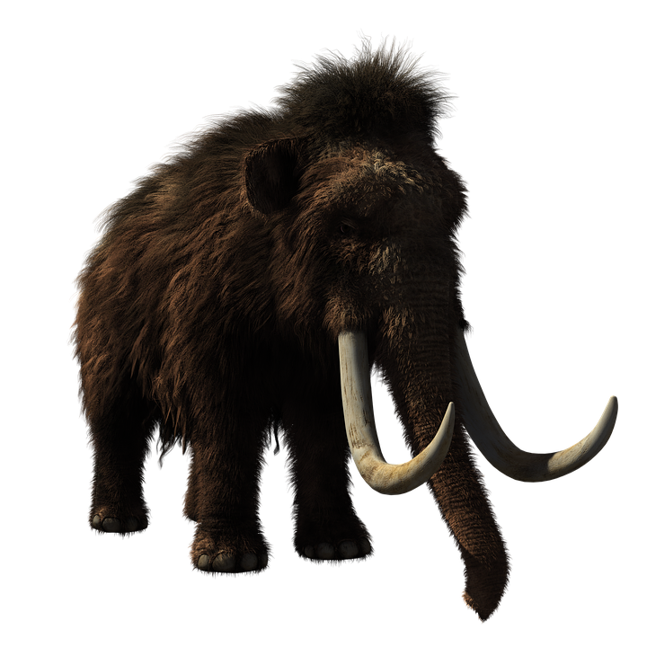
The Significance of Meiosis
Reduction of genetic material and sexual reproduction
The hair of wooly mammoths are an adaptation for cold climates.
Inheritance
Genetic diversity
Survival

Slide 24
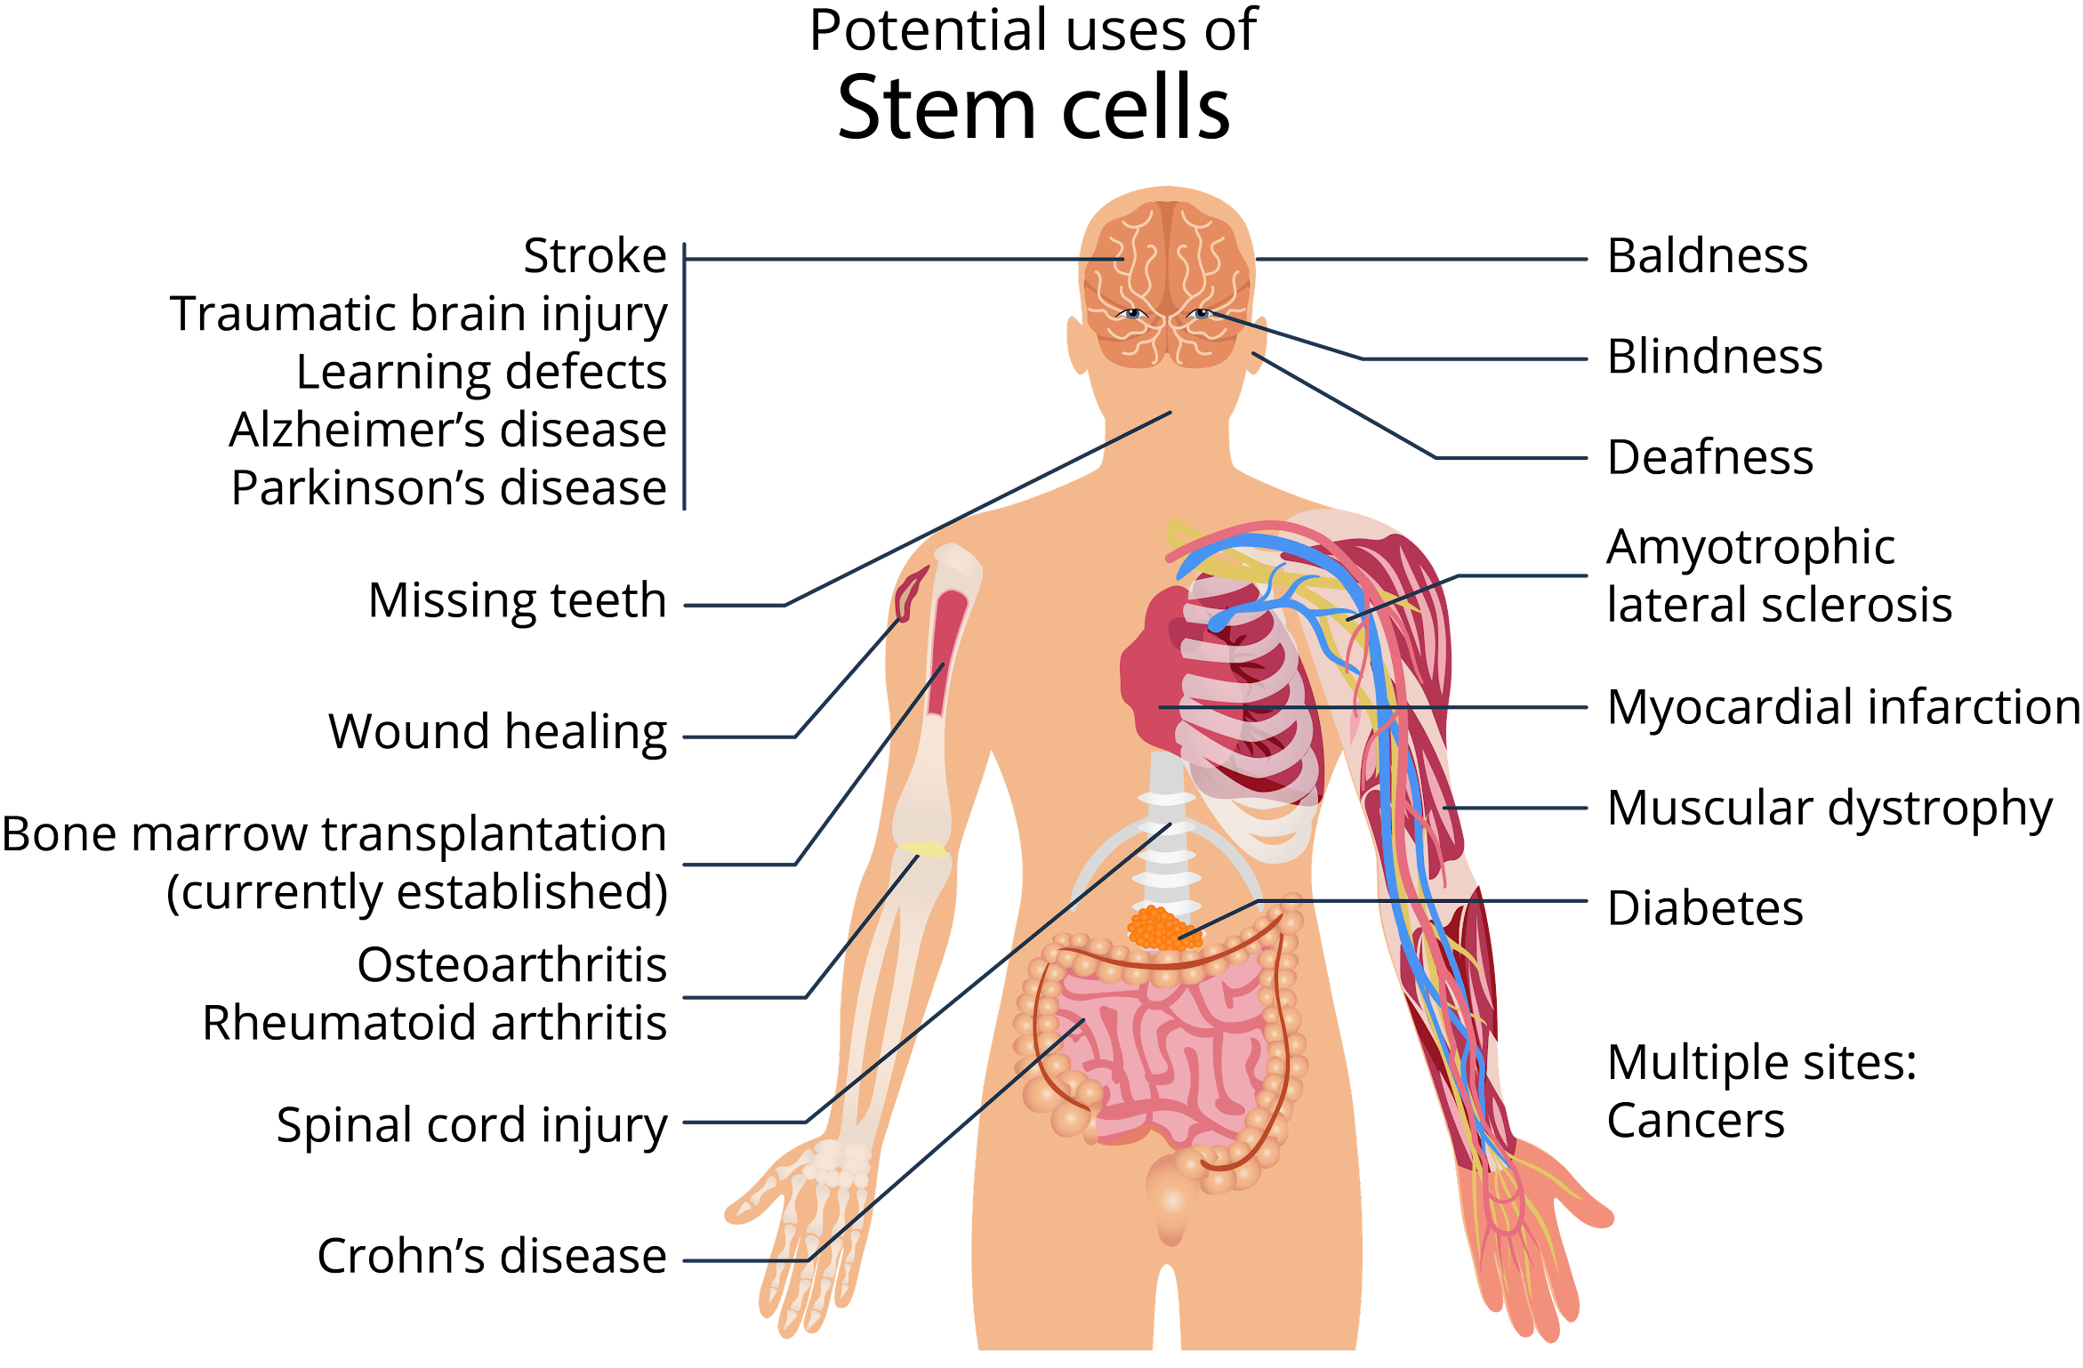
Applications of Mitosis and Meiosis
Stem Cell Technology
Applications of stem cell therapy range from genetic disorders to injuries.

Slide 25
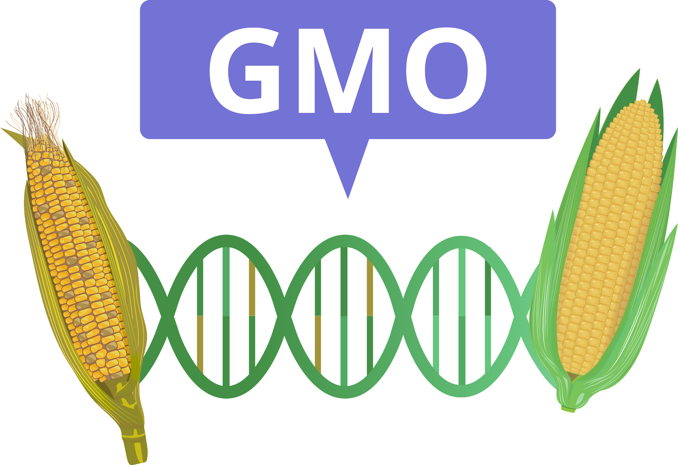
Applications of Mitosis and Meiosis
Genetic Engineering
Meiosis produces new cell variants, and mitosis proliferates genetically modified cells.
Corn plants are especially genetically manipulated to impart desirable traits such as resistance to pests and drought conditions.

Slide 26
Identify the term being described in each statement below.
This refers to the complete set of genes that an organism has.
This refers to an increase in size because of an increase in the number of cells or an increase in cell size.
This refers to the limit of the number of times that a cell can undergo mitosis.
26

Slide 27
Determine the accuracy of each of the following statements. Write true if the statement is accurate. Write false otherwise.
All organisms can undergo sexual reproduction.
Mitosis reduces the amount of genetic material in the daughter cells.
Growth is one application of mitosis.
27

Slide 28
Each organism has a complete set of genes that can be found in each cell. This complete set of genes is known as a genome. During mitosis, this must be completely inherited by successive cell generations.

Slide 29
Growth, in the biological sense, refers to an increase in body size usually because of an increase in the number of cells, a process achieved through mitotic divisions.

Slide 30
Cells are usually limited by a certain number of times that they can divide before being too aged to further undergo mitosis. This limit is known as the Hayflick limit.

Slide 31
Crossing over is when the homologous chromosomes in the tetrads exchange segments. This is an event during meiotic division that allows recombination of genes, and ultimately, enhances genetic variation.

Slide 32
Meiosis is essential in reducing the number of chromosomes during the production of gametes. It allows the restoration of the original chromosome number during fertilization.

Slide 33
The mechanisms of cellular division are highly taken advantage of in stem cell technology and in genetic engineering.

Slide 34
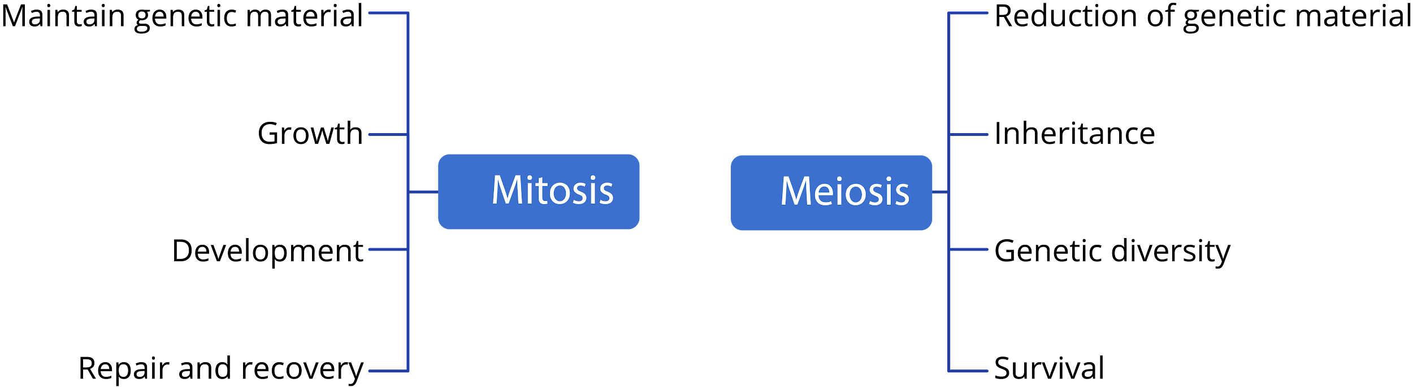
Applications and importance of mitosis and meiosis

Slide 35
Slide 22: Corncobs by Sam Fentress, is licensed under CC BY-SA 2.0 via Wikimedia Commons.
Boyer, Rodney F. Concepts in Biochemistry. Hoboken, NJ: Wiley, 2006.
Hickman, Cleveland P. Integrated Principles of Zoology. New York, NY: McGraw-Hill, 2011.
Miller, Stephen A., and John P. Harley. Zoology. New York, NY: McGraw-Hill, 2010.
Russell, Peter J. Biology: The Dynamic Science. Student Ed. Belmont, CA: Thomson/Brooks/Cole, 2008.
Starr, Cecie, Ralph Taggart, Christine A. Evers, and Lisa Starr. Biology: the Unity and Diversity of Life. Boston, MA: Cengage, 2019.

